Slide 1
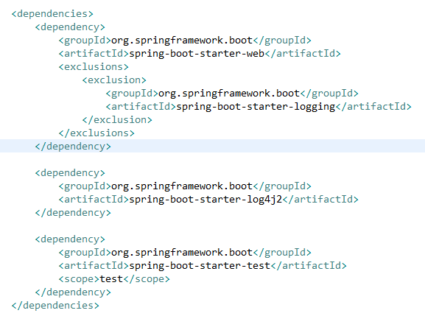
Spring boot log4j2 properties example
Spring boot’s default logging uses Logback which is included as transitive dependency. Spring Boot supports Log4j2 for logging configuration if it is on the classpath.
To configure log4j2 , First remove spring’s default logging dependency (spring-boot-starter-logging) and then add log4j2 dependency (spring-boot-starter-log4j2).

Slide 2
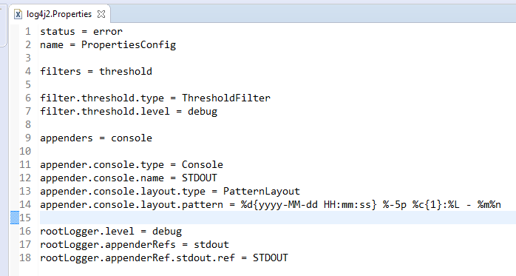
Spring boot log4j2 properties example
We have to add log4j2.properties or (log4j2.xml) in src/main/resources folder.

